Slide 1


Elia Gomez
03-13-2025

Slide 2

Outline
Executive Summary
Introduction
Methodology
Results
Conclusion
Appendix

Slide 3
Executive Summary
Summary of methodologies
Data Collection
API Data Collection
Web Scrapping
Data Wrangling
Format Data Using Python Pandas
SQL: Query Data
Exploratory Data Analysis: Visualize Trends and Relationships
Machine Learning:
Built models and Evaluate Performance
Summary of Results
Created and evaluated different models with an accuracy result of 87%

Slide 4
Introduction
Project background and context
SpaceX advertises Falcon 9 rocket launches on its website with a cost of 62 million dollars; other providers cost upward of 165 million dollars each, much of the savings is because SpaceX can reuse the first stage.
Problems you want to find answers
Predict if the Falcon 9 first stage will land successfully
Determine if the first stage will land,
Determine the cost of a launch.

Slide 5

Section 1

Slide 6
Methodology
Executive Summary
Data collection methodology:
Data was obtained using Api calls to public data sources and web scraping using Python libraries (BeautifulSoup)
Data wrangling
Data was cleaned and processed using Pandas
Exploratory data analysis (EDA) using visualization and SQL
Interactive visual analytics using Folium and Plotly Dash
Predictive analysis using classification models
Developed 4 machine learning models to predict successful first stage landings, tuned using GridSearchCV, model performance evaluation using F1 scores

Slide 7
Data Collection – SpaceX API
API Request
API Request → Sent GET request to
https://api.spacexdata.com/v4/launches/past
JSON Response → Retrieved structured launch data
Data Processing → Converted JSON to Pandas Data Frame
Feature Extraction → Selected key attributes (Launch, Site, Payload, Booster, Orbit)
Data Cleaning → Handled missing values, standardized formats
Final Dataset → Ready for EDA & Machine Learning
Data Collection Github Link
JSON Response
Data Processing
Feature Extraction
Data Cleaning
Final Dataset

Slide 8
Data Collection - Scraping
Identify Target Source
Identify Target Source → Wikipedia Falcon 9 launch history tables
Fetch HTML Content → Used requests.get(URL) to retrieve webpage data
Parse HTML → Leveraged BeautifulSoup to extract structured table elements
Extract Relevant Data → Retrieved Flight No., Launch Site, Payload, Orbit, and Landing Outcome
Clean & Store → Converted extracted data into a Pandas data Frame for further processing
Web Scraping Github Link
Fetch HTML Content
Parse HTML
Extract Relevant Data
Clean & Store

Slide 9
Data Wrangling
Load & Inspect Data → Read datasets (API & Web Scraped) into Pandas DataFrames
Handle Missing Values → Identified & replaced NaN values in key columns
Standardize Formats → Converted date-time formats & ensured consistency across fields
Remove Irrelevant Columns → Dropped unnecessary fields like references & redundant IDs
Transform Categorical Data → Used One-Hot Encoding for categorical variables (e.g., Launch Site, Orbit)
Merge & Store Cleaned Data → Combined API & Web Scraped datasets into a unified dataset
Data Wrangling Github Link

Slide 10
EDA with Data Visualization
Flight Number vs. Payload Mass (Scatter Plot) – Shows impact on landing success.
Launch Site vs. Flight Number (Categorical Plot) – Compares site-wise success rates.
Payload Mass vs. Orbit Type (Scatter Plot) – Assesses orbit-type success for payloads.
Orbit Type vs. Success Rate (Bar Chart) – Identifies most reliable orbits.
Yearly Launch Success Trend (Line Chart) – Tracks SpaceX’s improvement over time.
EDA Data Visualization Github Link

Slide 11
EDA with SQL
Display the names of the unique launch sites in the space mission
Display 5 records where launch sites begin with the string 'CCA'
Display the total payload mass carried by boosters launched by NASA (CRS)
Display average payload mass carried by booster version F9 v1.1
List the date when the first successful landing outcome in ground pad was achieved.
List the names of the boosters which have success in drone ship and have payload mass greater than 4000 but less than 6000
List the total number of successful and failure mission outcomes
List the names of the booster_versions which have carried the maximum payload mass. Use a subquery
List the records which will display the month names, failure landing_outcomes in drone ship ,booster versions, launch_site for the months in year 2015.
Rank the count of landing outcomes (such as Failure (drone ship) or Success (ground pad)) between the date 2010-06-04 and 2017-03-20, in descending order.
EDA with SQL Github Link

Slide 12
Build an Interactive Map with Folium
Map Objects Created:
Markers:
Plotted markers at each launch site to visualize geographic distribution.
Used different colors to represent successful and failed launches.
Circles:
Added circles around launch sites to indicate proximity to infrastructure like highways and coastlines.
Circle size reflected the number of launches at each site.
Polylines (Lines):
Connected launch sites to the landing location to illustrate the trajectory of successful landings.
Different line styles were used for successful and failed trajectories.
Markers provided a clear view of the location and success rate of each launch site.
Circles helped identify infrastructure proximity and how it might affect landing success.
Polylines allowed for analyzing flight paths and determining whether trajectory influenced landing success.

Slide 13
Build a Dashboard with Plotly Dash
Dropdown Menu (Launch Site Selection):
Filter data by individual launch sites or view all sites.
Pie Chart (Launch Success Distribution):
Displayed the proportion of successful vs. failed
launches per site.
Identify the site with the highest success rate.
Range Slider (Payload Mass Selection):
Allowed users to filter launch data based on
payload mass range.
Scatter Plot (Payload vs. Launch Success):
Relationship between payload mass
and mission success.
Why These Plots?
Plotly dashboard enabled interactive visual analytics, allowing users to explore how launch sites, payload mass, and booster versions influenced SpaceX launch success.
Plotly Dashboard Github Link

Slide 14
Predictive Analysis (Classification)
Data Preprocessing: Cleaned the dataset by handling missing values, applied One-Hot-Encoding to convert categorical variables, normalized numerical features for better model performance
Featured Selection: Identified key features that influence landing success, remove irrelevant columns like booster version, Serial, and Landing Pad
Splitting Data: 80% of the data was used for training, 20% of the data was used for testing
Predictive Analysis Github Link

Slide 15
Predictive Analysis (Classification)
Model Training Trained multiple models, Logistic Regression, Support Vector Machine (SVM), Decision tree, K-nearest Neighbors (KNN)
Hyperparameter Tuning Used GridSearchCV to optimized the models
Model Evaluation: Measure accuracy, precision, recall, and F1-score
Selecting Best Model: Cleaned Decision Tree achieved the highest accuracy: 87.3%, Selected as the final model for predicting Falcon 9 landings
Predictive Analysis Github Link

Slide 16
Predictive Analysis (Classification)
Data Preprocessing
Featured Selection
Splitting Data
Model Training
Hyperparameter Tuning
Model Evaluation
Selecting Best Model

Slide 17
Results
Exploratory data analysis results
Payload mass for specific launch sites can affect success outcomes
F9B5 designed for heavy Payloads
Interactive analytics demo in screenshots
Pie Chart allowed visualization of success rates
Range Slider enabled analysis on payload mass
Predictive analysis results
Best Model: Decision Tree achieved the highest accuracy: 87.3%,
Payload Mass and launch site important factors

Slide 18

Section 2

Slide 19
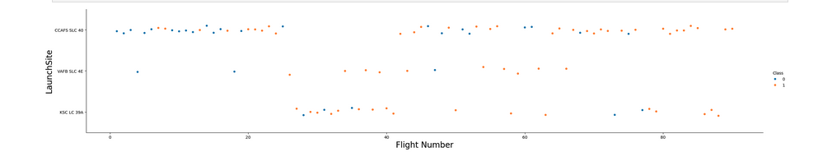
Flight Number vs. Launch Site
CCAFS SLC 40 show higher flights number which correlate with higher success rate

Slide 20
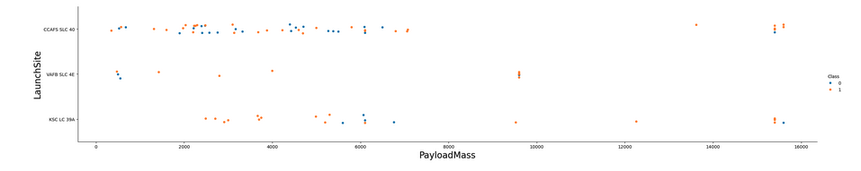
Payload vs. Launch Site
Heavy payloads more success.

Slide 21
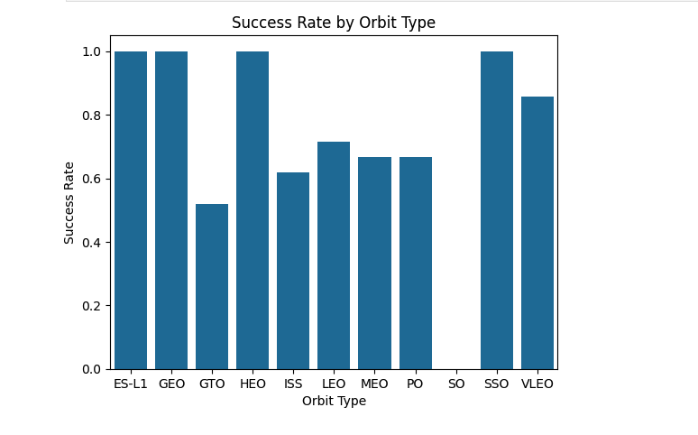
Success Rate vs. Orbit Type
Only 4 Orbits type reach the same success rate

Slide 22
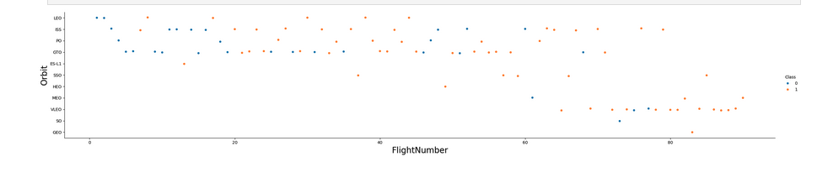
Flight Number vs. Orbit Type
The same 4 Orbits that reach the same success rate, are the ones with a small numbers of flights

Slide 23
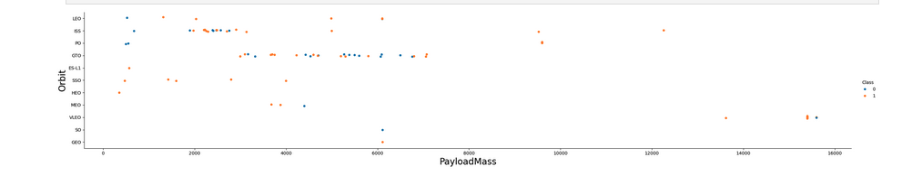
Payload vs. Orbit Type
For heavy payloads more than 10.000 only 3 orbits available
Payload less than 10.000 are distributed in some orbits.

Slide 24
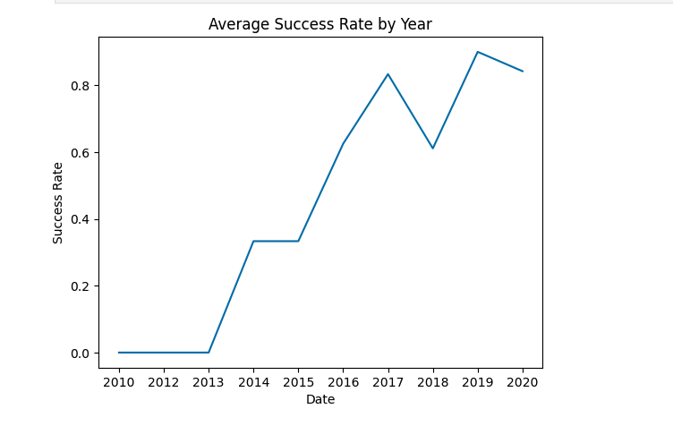
Launch Success Yearly Trend
Since 2013 we see a huge improvement, increasing success rate in an exponential way until 2017, reaching a balance point in 2018.

Slide 25
All Launch Site Names
%sql SELECT DISTINCT Launch_Site FROM SPACEXTABLE;
Launch_Site
CCAFS LC-40
VAFB SLC-4E
KSC LC-39A
CCAFS SLC-40
Only 4 Launch sites

Slide 26
Launch Site Names Begin with 'CCA'
%sql SELECT * FROM SPACEXTABLE WHERE Launch_Site LIKE 'CCA%' LIMIT 5;
Result is CCAFS LC-40 meaning same launch site, and same LEO orbit, with mission outcome Success!
Date | Time (UTC) | Booster_Version | Launch_Site | Payload | PAYLOAD_MASS__KG_ | Orbit | Customer | Mission_Outcome | Landing_Outcome
2010-06-04 | 18:45:00 | F9 v1.0 B0003 | CCAFS LC-40 | Dragon Spacecraft Qualification Unit | 0 | LEO | SpaceX | Success | Failure (parachute)
2010-12-08 | 15:43:00 | F9 v1.0 B0004 | CCAFS LC-40 | Dragon demo flight C1, two CubeSats, barrel of Brouere cheese | 0 | LEO (ISS) | NASA (COTS) NRO | Success | Failure (parachute)
2012-05-22 | 7:44:00 | F9 v1.0 B0005 | CCAFS LC-40 | Dragon demo flight C2 | 525 | LEO (ISS) | NASA (COTS) | Success | No attempt
2012-10-08 | 0:35:00 | F9 v1.0 B0006 | CCAFS LC-40 | SpaceX CRS-1 | 500 | LEO (ISS) | NASA (CRS) | Success | No attempt
2013-03-01 | 15:10:00 | F9 v1.0 B0007 | CCAFS LC-40 | SpaceX CRS-2 | 677 | LEO (ISS) | NASA (CRS) | Success

Slide 27
Total Payload Mass
The total payload carried by boosters from NASA: 45596
%sql SELECT SUM(PAYLOAD_MASS__KG_) FROM SPACEXTABLE WHERE Customer LIKE 'NASA (CRS)’;
SUM(PAYLOAD_MASS__KG_)
45596

Slide 28
Average Payload Mass by F9 v1.1
Average payload mass carried by booster version F9 v1.1
%sql SELECT AVG(PAYLOAD_MASS__KG_) FROM SPACEXTABLE WHERE Booster_Version LIKE 'F9 v1.1’;
AVG(PAYLOAD_MASS__KG_)
2928.4

Slide 29
First Successful Ground Landing Date
First successful landing outcome on ground pad: 2015-12-22
%sql SELECT MIN(Date) FROM SPACEXTABLE WHERE Landing_Outcome = 'Success (ground pad)’;
MIN(Date)
2015-12-22

Slide 30
Successful Drone Ship Landing with Payload between 4000 and 6000
Names of boosters which have successfully landed on drone ship and had payload mass greater than 4000 but less than 6000
%sql SELECT Booster_Version FROM SPACEXTABLE WHERE Landing_Outcome = 'Success (drone ship)' AND PAYLOAD_MASS__KG_ BETWEEN 4000 AND 6000;
Booster_Version
F9 FT B1022
F9 FT B1026
F9 FT B1021.2
F9 FT B1031.2

Slide 31
Total Number of Successful and Failure Mission Outcomes
Total number of successful and failure mission outcomes
%sql SELECT Mission_Outcome, COUNT(*) AS Total FROM SPACEXTABLE GROUP BY Mission_Outcome;
Mission_Outcome | Total
Failure (in flight) | 1
Success | 98
Success | 1
Success (payload status unclear) | 1

Slide 32
Boosters Carried Maximum Payload
Names of the booster which have carried the maximum payload mass
F9B5 designed for heavy Payloads
%sql SELECT Booster_Version FROM SPACEXTABLE WHERE PAYLOAD_MASS__KG_ = (SELECT MAX(PAYLOAD_MASS__KG_) FROM SPACEXTABLE);
Booster_Version
F9 B5 B1048.4
F9 B5 B1049.4
F9 B5 B1051.3
F9 B5 B1056.4
F9 B5 B1048.5
F9 B5 B1051.4
F9 B5 B1049.5
F9 B5 B1060.2
F9 B5 B1058.3
F9 B5 B1051.6
F9 B5 B1060.3
F9 B5 B1049.7

Slide 33
2015 Launch Records
Failed landing_outcomes in drone ship, their booster versions, and launch site names for in year 2015
%sql SELECT substr(Date, 6, 2) AS Month, Landing_Outcome, Booster_Version, Launch_Site FROM SPACEXTABLE WHERE substr(Date, 1, 4) = '2015' AND Landing_Outcome = 'Failure (drone ship)';
Month | Landing_Outcome | Booster_Version | Launch_Site
01 | Failure (drone ship) | F9 v1.1 B1012 | CCAFS LC-40
04 | Failure (drone ship) | F9 v1.1 B1015 | CCAFS LC-40

Slide 34
Rank Landing Outcomes Between 2010-06-04 and 2017-03-20
Count of landing outcomes (such as Failure (drone ship) or Success (ground pad)) between the date 2010-06-04 and 2017-03-20, in descending order
%sql SELECT Landing_Outcome, COUNT(*) AS Count FROM SPACEXTABLE WHERE Date BETWEEN '2010-06-04' AND '2017-03-20' GROUP BY Landing_Outcome ORDER BY Count DESC;
Landing_Outcome | Count
No attempt | 10
Success (drone ship) | 5
Failure (drone ship) | 5
Success (ground pad) | 3
Controlled (ocean) | 3
Uncontrolled (ocean) | 2
Failure (parachute) | 2
Precluded (drone ship) | 1

Slide 35

Section 3

Slide 36
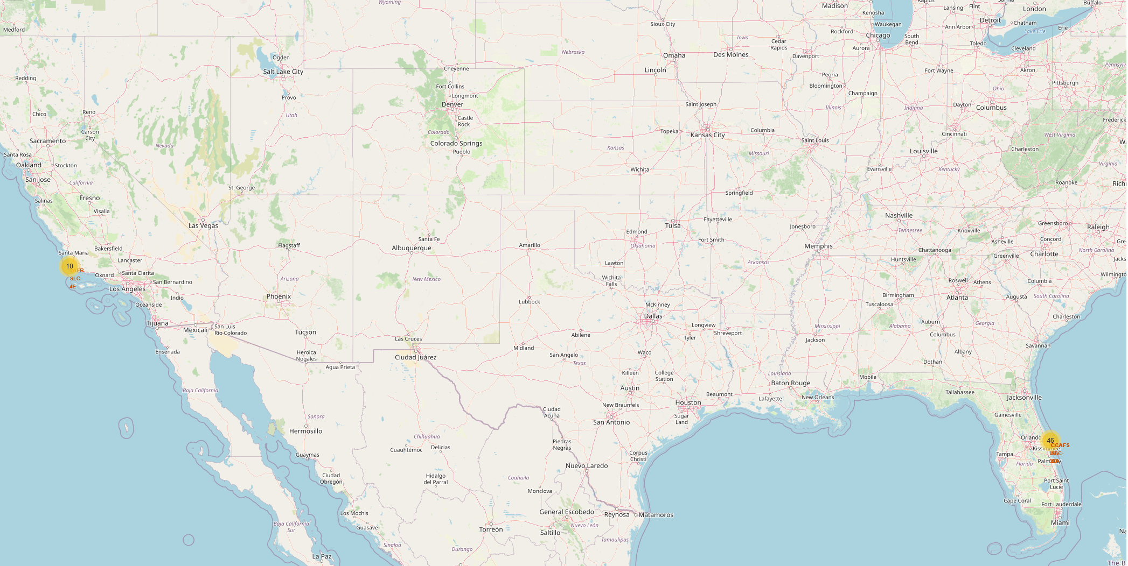
Launch Site Locations With Markers
Important elements and findings on the screenshot
CCAFS SLC-40 – Cape Canaveral Air Force Station (USA)
VAFB SLC-4E – Vandenberg Air Force Base (USA)
KSC LC-39A – Kennedy Space Center (USA)

Slide 37
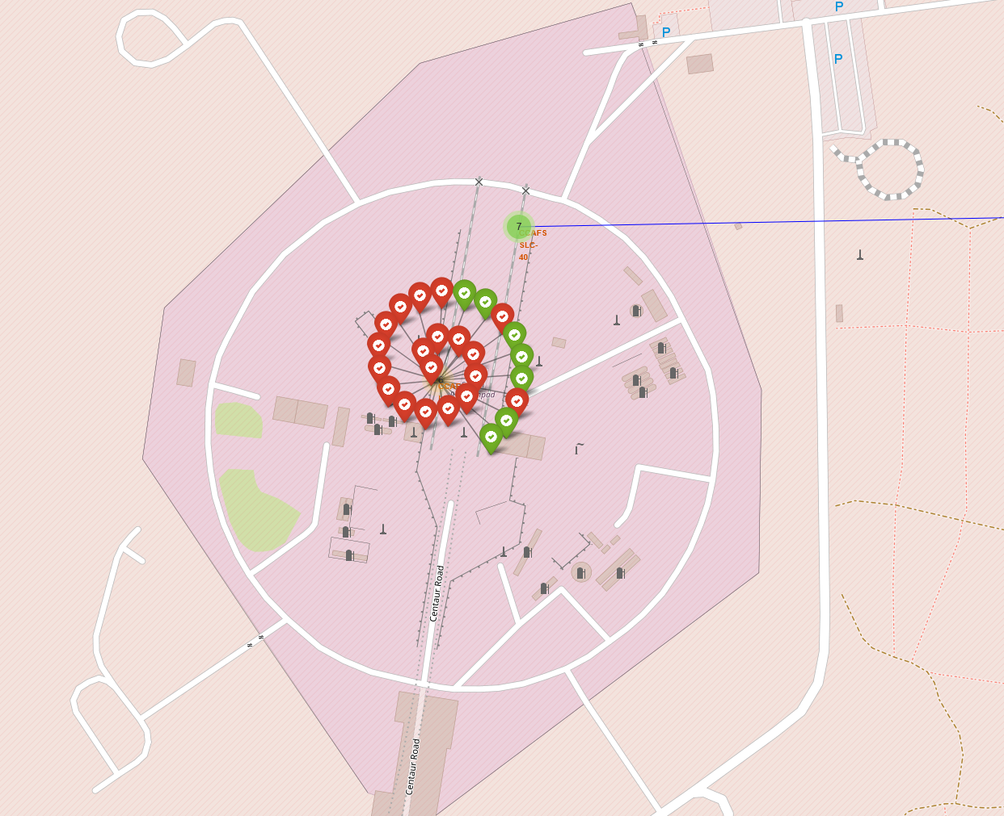
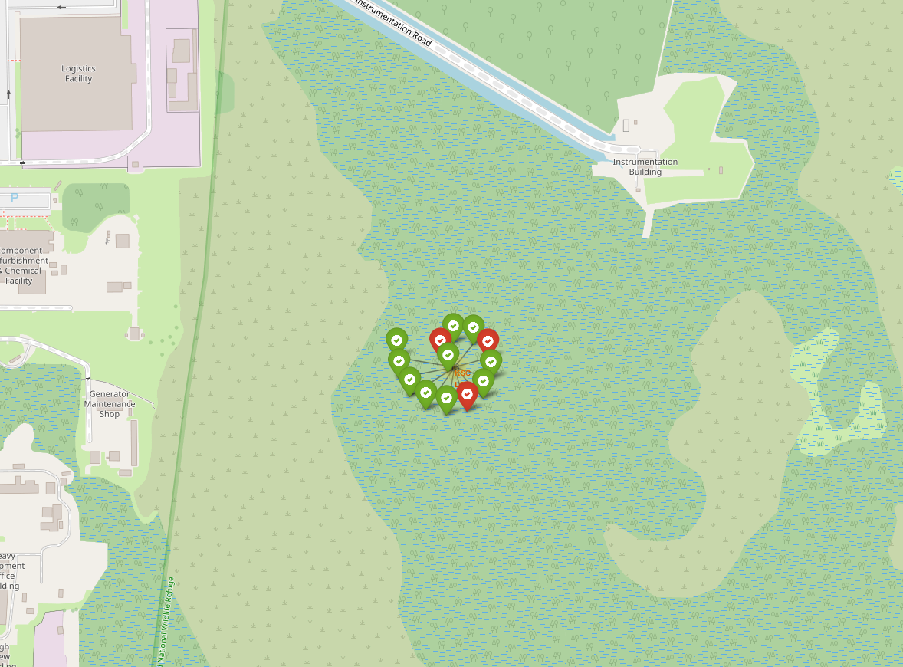
Launch Outcomes Mapped
Explain the important elements and findings on the screenshot

Slide 38
<Folium Map Screenshot 3>
Replace <Folium map screenshot 3> title with an appropriate title
Explore the generated folium map and show the screenshot of a selected launch site to its proximities such as railway, highway, coastline, with distance calculated and displayed
Explain the important elements and findings on the screenshot

Slide 39

Section 4

Slide 40
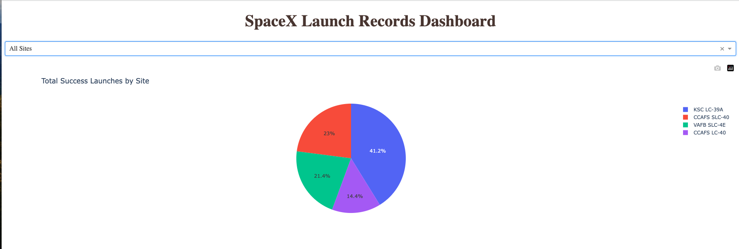
Total Success Launches by Site
Explain the important elements and findings on the screenshot

Slide 41
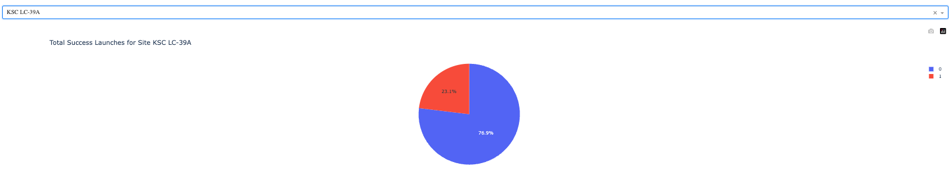
Highest Success Ratio
Explain the important elements and findings on the screenshot

Slide 42
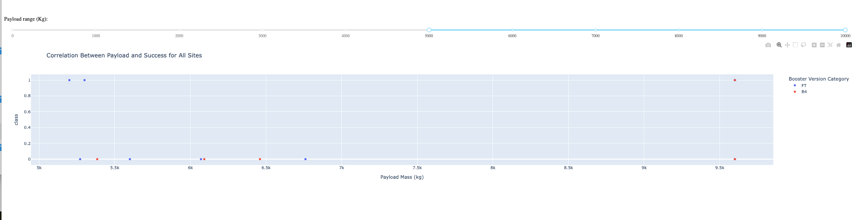
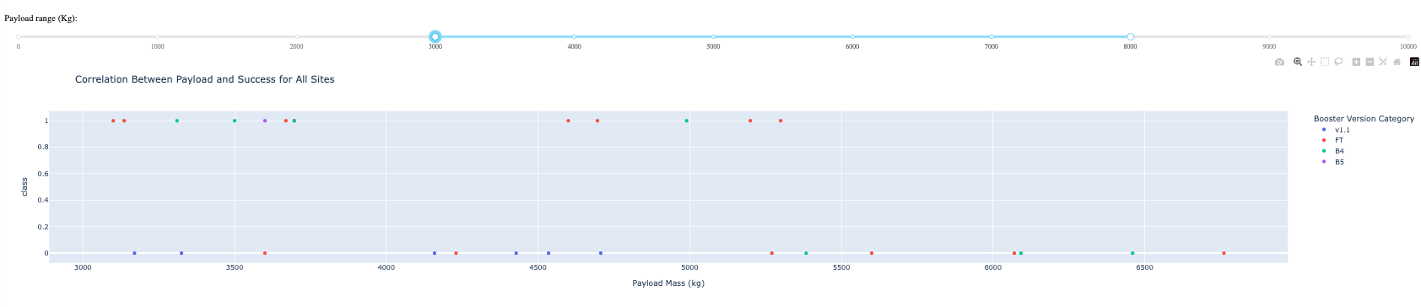
Scatterplots – Payload and Success Correlation
Explain the important elements and findings on the screenshot, such as which payload range or booster version have the largest success rate, etc.

Slide 43

Section 5

Slide 44
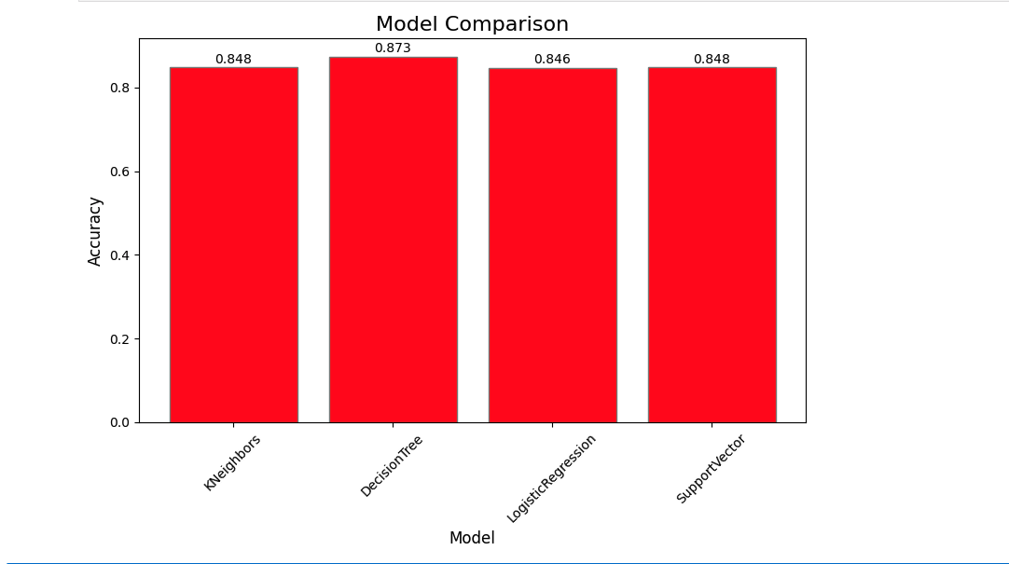
Classification Accuracy
Decision Tree Model has the highest classification accuracy 87.3%

Slide 45
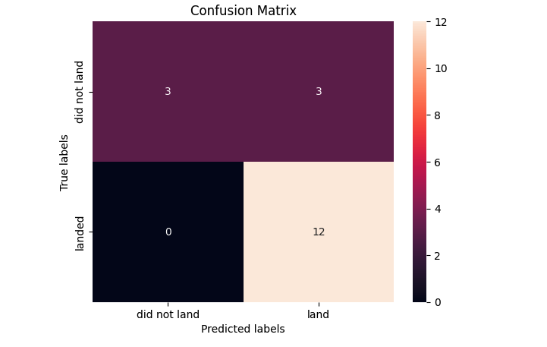
Confusion Matrix
Show the confusion matrix of the best performing model with an explanation

Slide 46
Conclusions
Point 1
Point 2
Point 3
Point 4
…

Slide 47
Appendix

Slide 48


